Slide 1
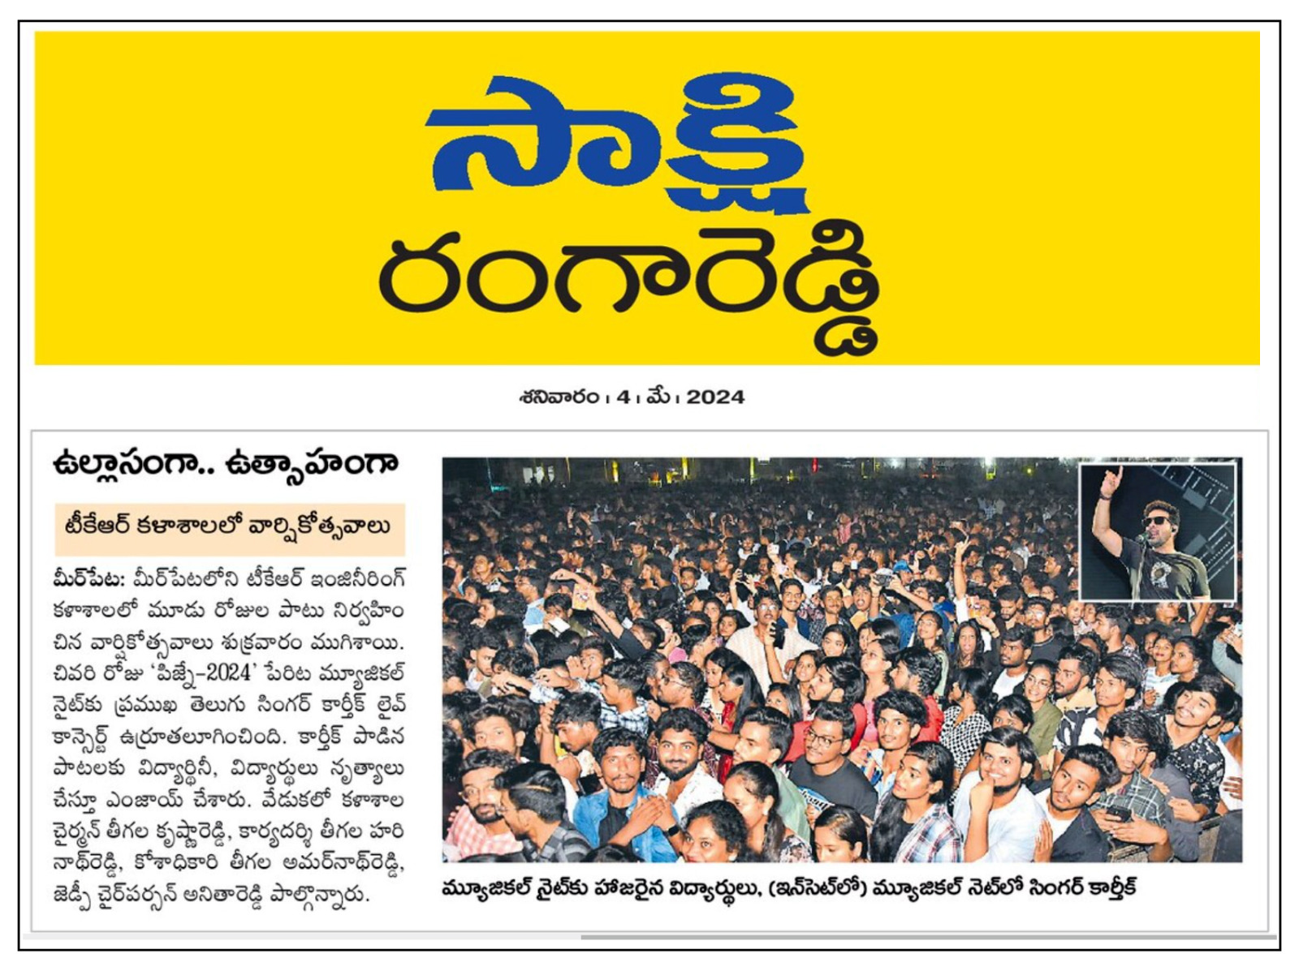
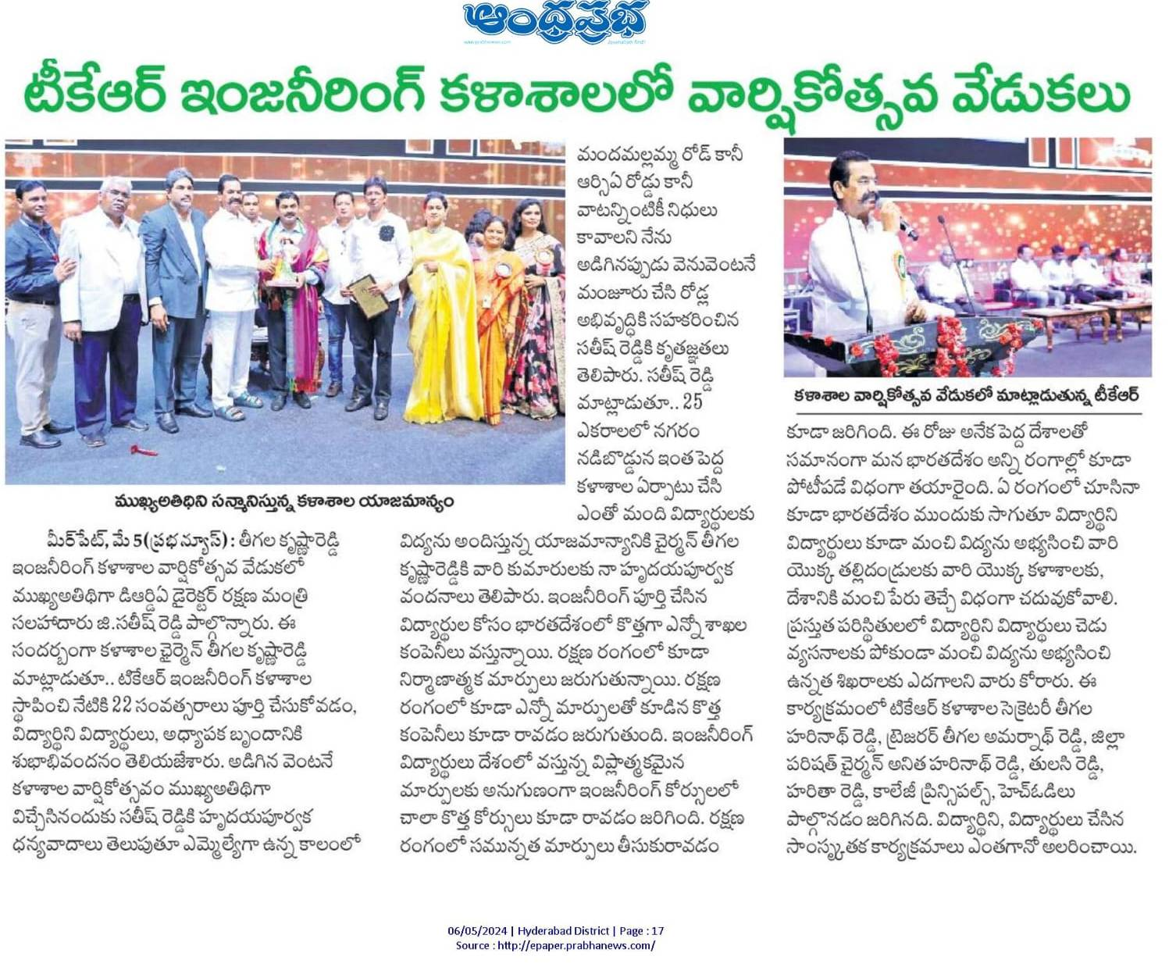
2024
PRESS RELEASED CLIPS
SAKSHI, 04-05-2024
ANDHRA PRABHA, 04-05-2024

Slide 2
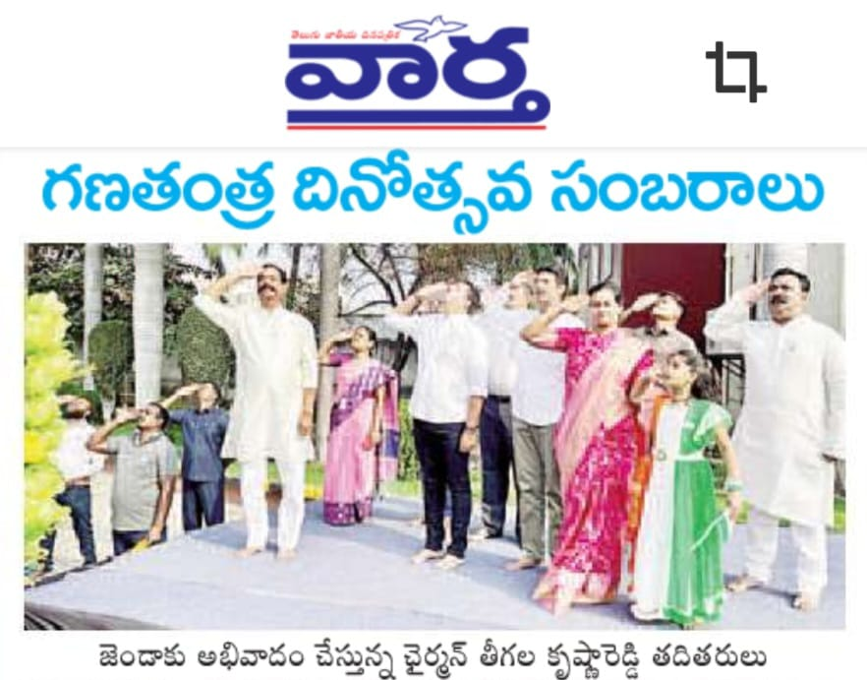
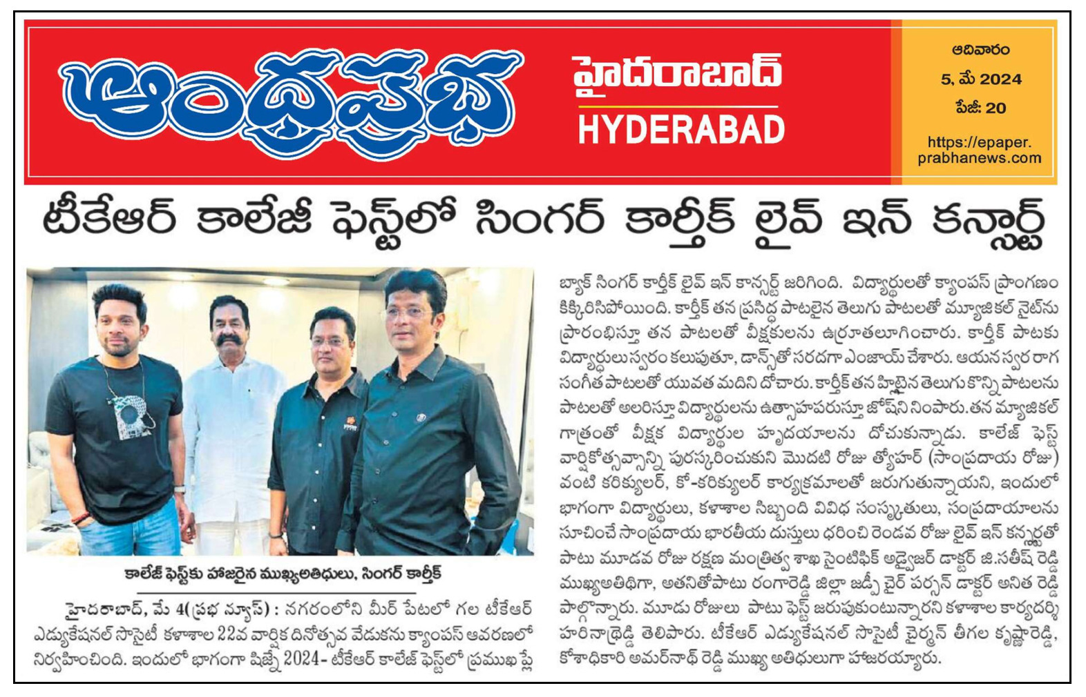
2024
PRESS RELEASED CLIPS
VARTHA, 27-01-2024
ANDHRA PRABHA, 05-05-2024

Slide 3
2024
PRESS RELEASED CLIPS
THE SOUTH INDIA TIMES, 05-05-2024

Slide 4
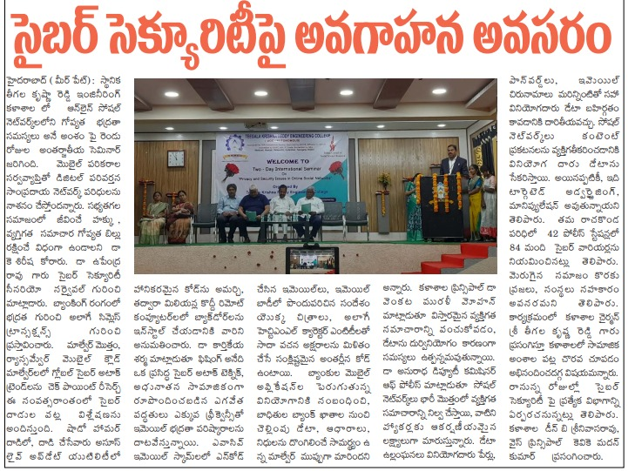
2023
PRESS RELEASED CLIPS
PRAJA SHAKTHI, 02-09-2023

Slide 5
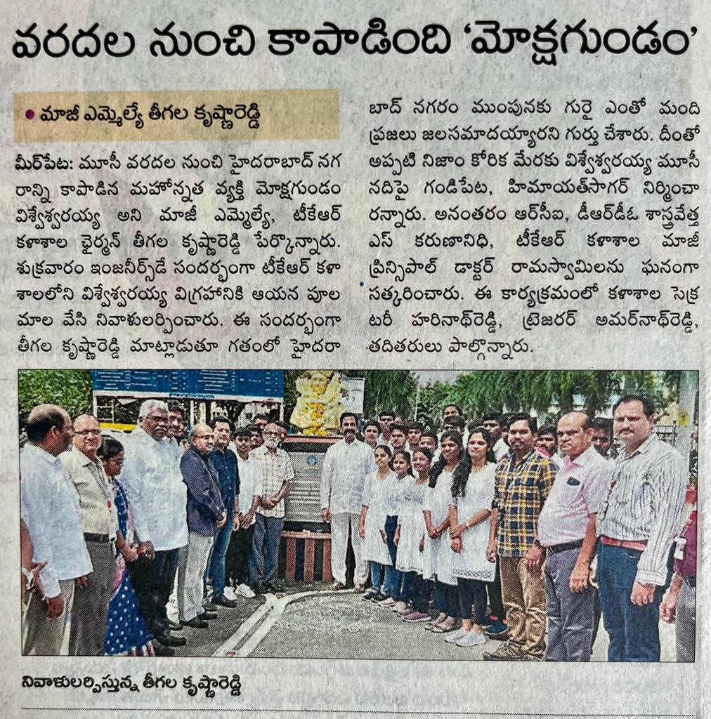
2023
PRESS RELEASED CLIPS
NEWS TODAY, 05-09-2023

Slide 6
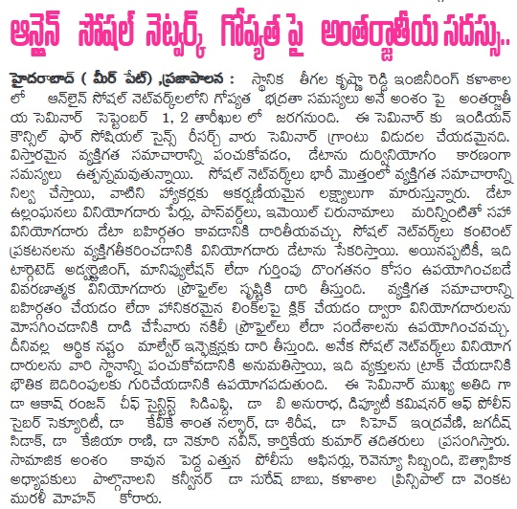
2023
PRESS RELEASED CLIPS
PRAJA PALANA, 01-09-2023

Slide 7
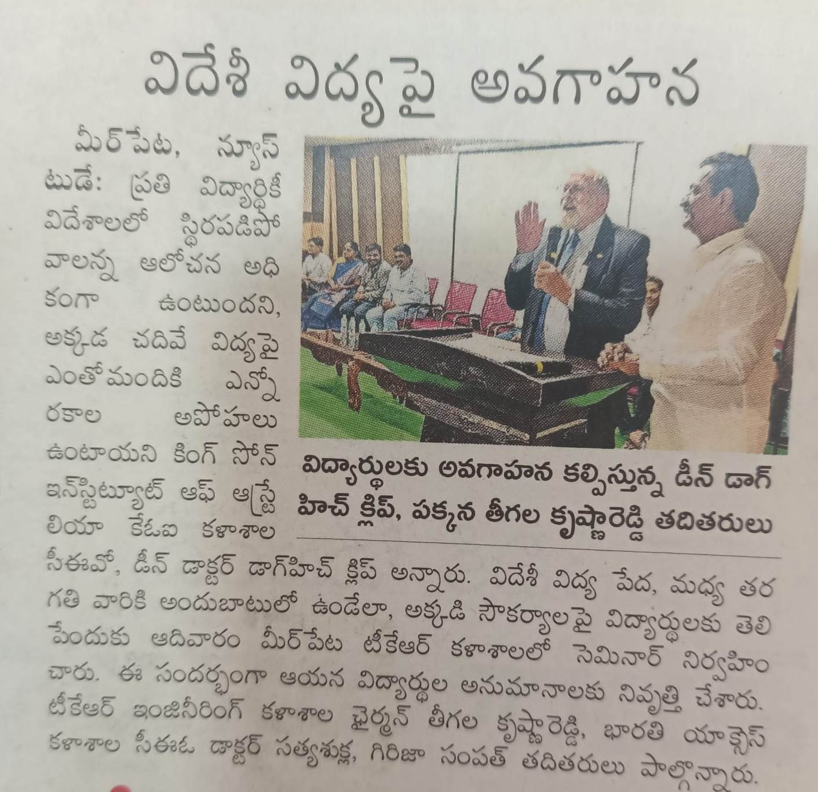
2023
PRESS RELEASED CLIPS
EENADU, 22-01-2023

Slide 8
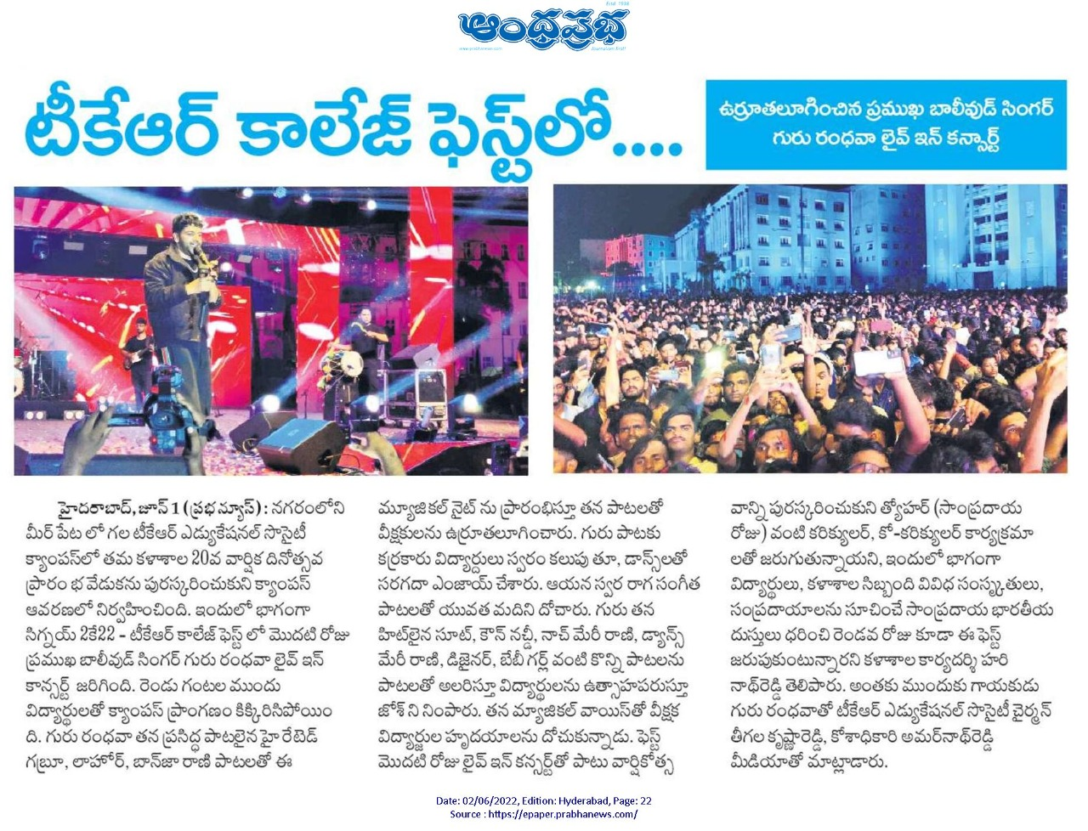
2022
PRESS RELEASED CLIPS
ANDHRAPRABHA, 02-06-2022

Slide 9
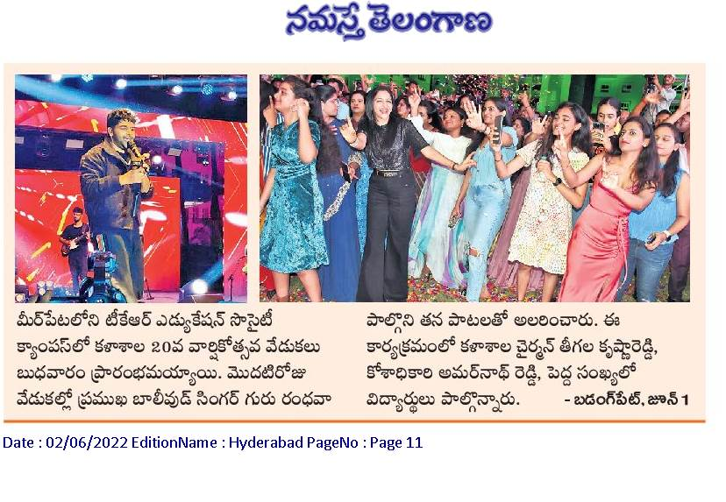
2022
PRESS RELEASED CLIPS
ANDHRAPRABHA, 02-06-2022

Slide 10
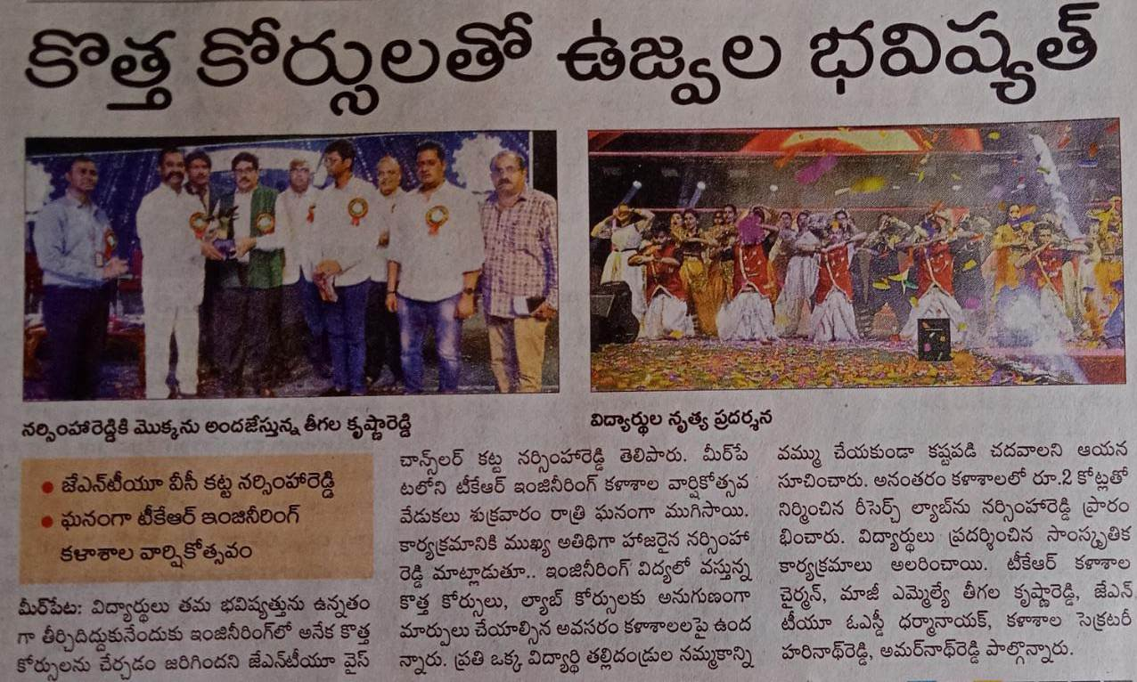
2022
PRESS RELEASED CLIPS
EENADU, 22-01-2023

Slide 11
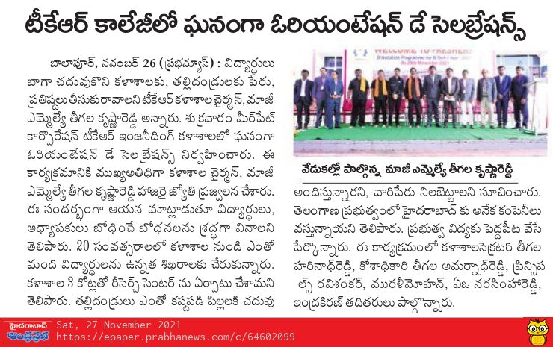
2021
PRESS RELEASED CLIPS
ANDHRA PRABHA, 27-11-2021

Slide 12
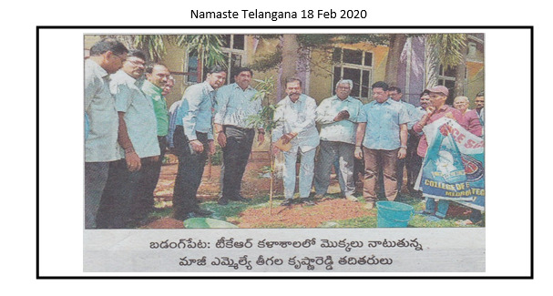
2020
PRESS RELEASED CLIPS
NAMASTE TALANGANA, 18-02-2020

Slide 13
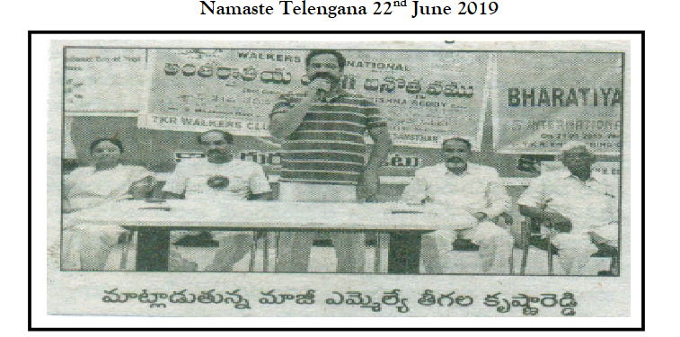
2019
PRESS RELEASED CLIPS
NAMASTHE TELANGANA, 22-06-2029

Slide 14
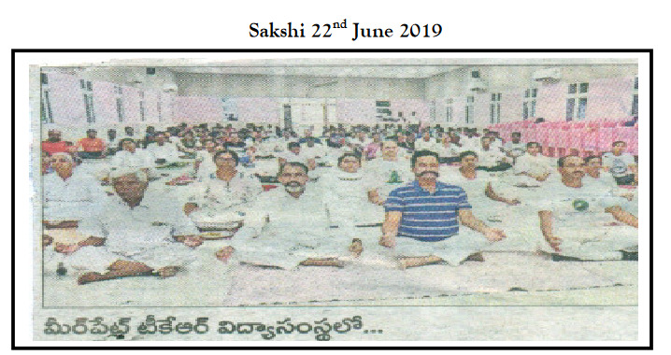
2019
PRESS RELEASED CLIPS
SAKSHI, 22-06-2029

